Slide 1

Robotics & Automation Driven Precision Ag Solutions for Public Sector and Industry in Pakistan
Dr Abubakr Muhammad
Associate Professor of Electrical Engineering, SBASSE
Director, Center for Water Informatics & Technology (WIT)
Lahore University of Management Sciences, Pakistan
http://cyphynets.lums.edu.pk
http://wit.lums.edu.pk/

Slide 2
Outline
The promise of water informatics and precision agriculture
Science and systems
Taking science to industry solutions
Conclusions

Slide 3
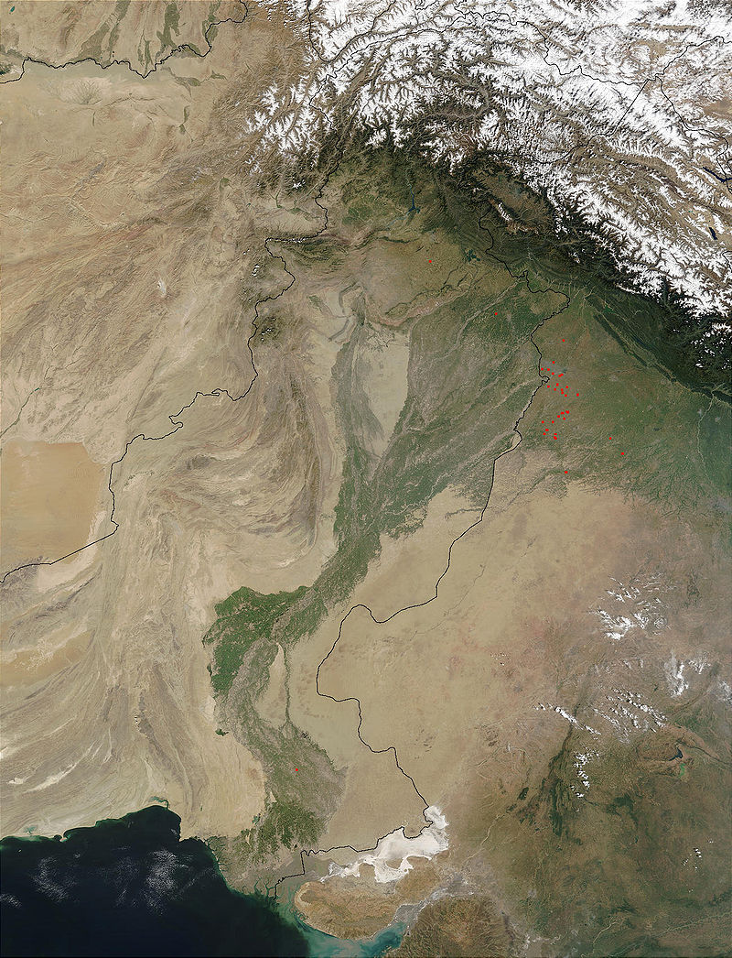
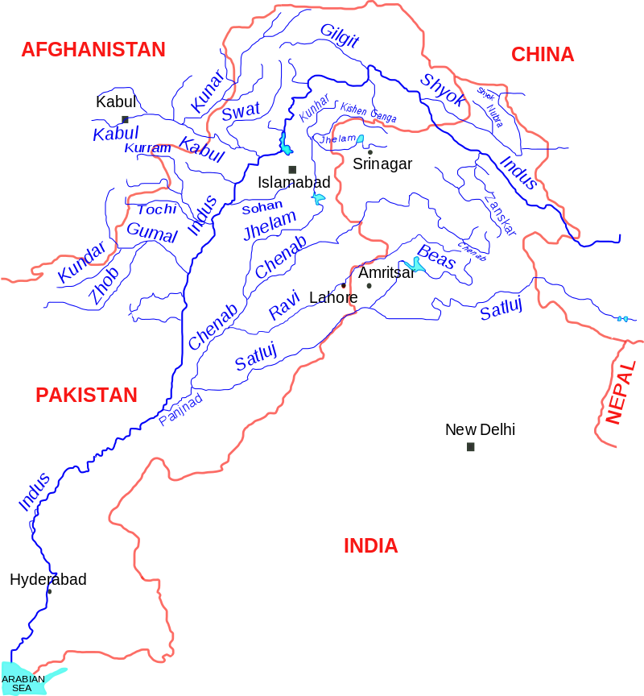
The Indus River Basin

Slide 4
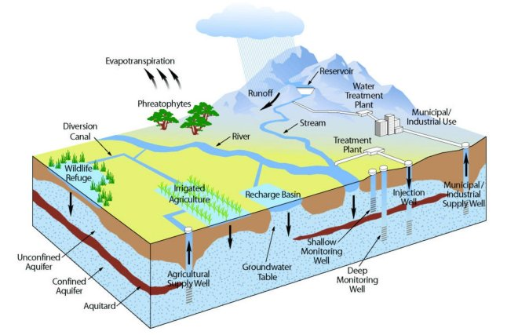
River Basin Management:
A complex system of systems
Water
Silt
Salt

Slide 5
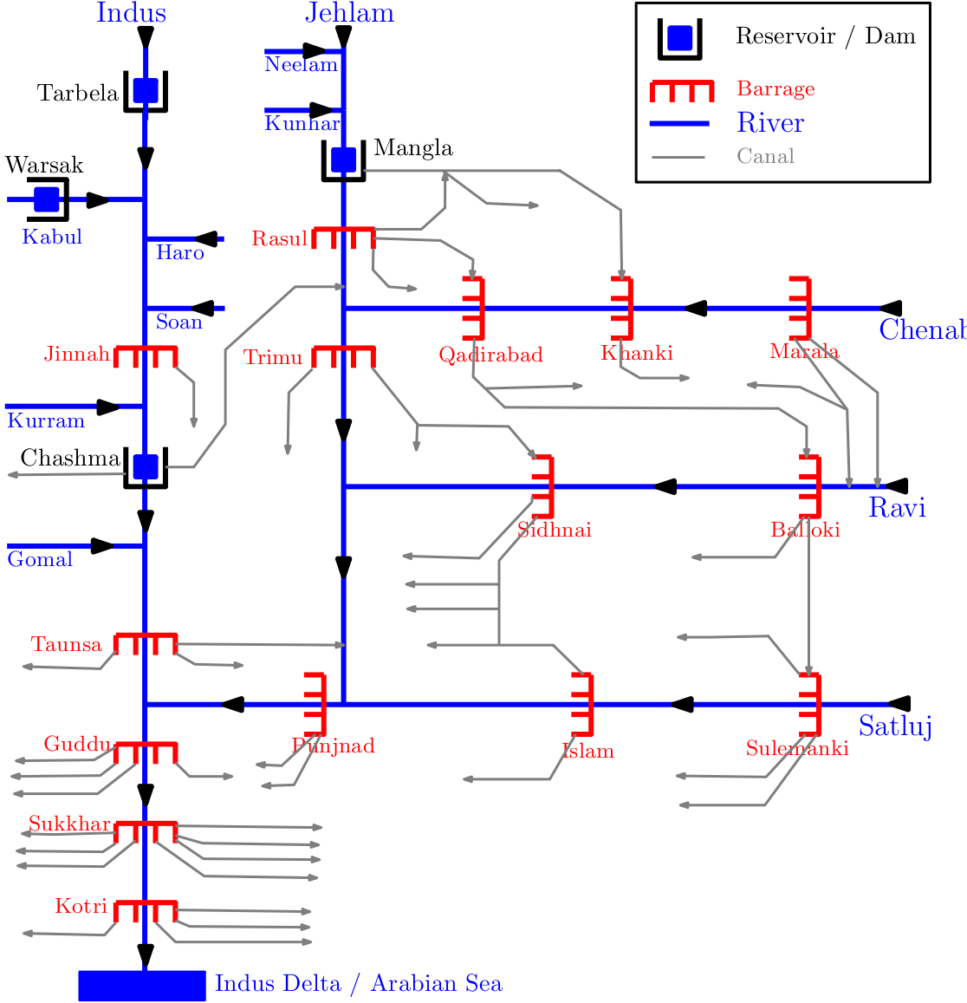
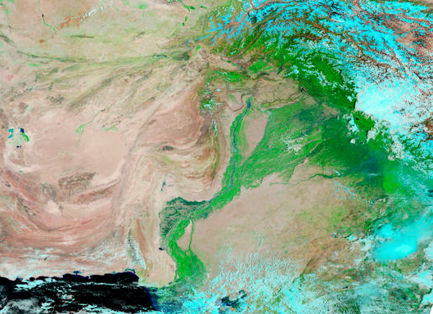
Managing the World’s Largest Irrigation Network
> 90,000 Km of watercourses
3 reservoirs, 23 barrages
45 canal commands
> 40 million acre irrigated area

Slide 6
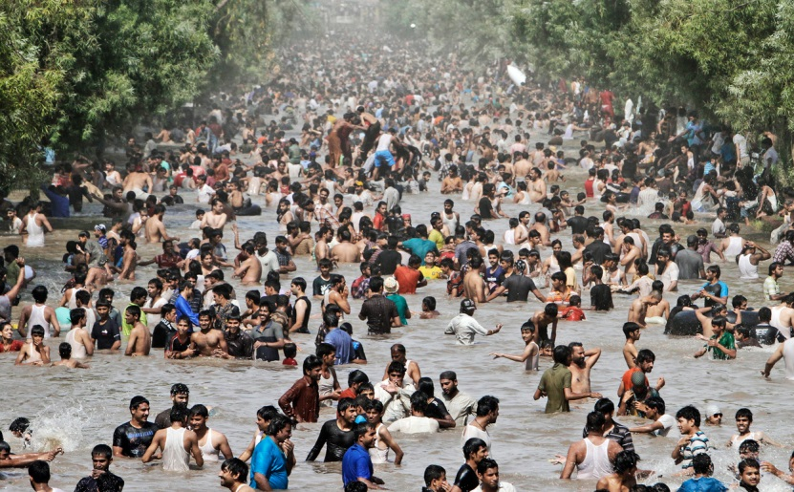
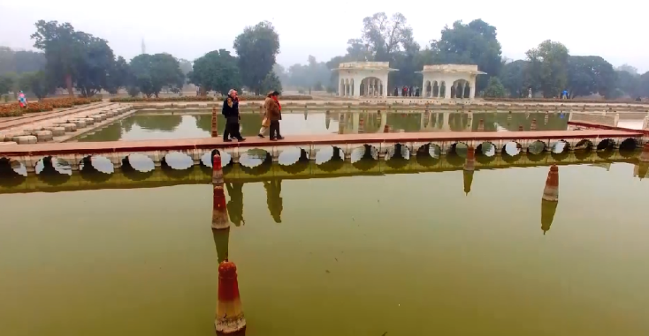
Managing the World’s Largest Irrigation Network
> 90,000 Km of watercourses
3 reservoirs, 23 barrages
45 canal commands
> 40 million acre irrigated area
200 Million population
45% employment in Agriculture
25% of GDP

Slide 7
Managing the World’s Largest Irrigation Network
Challenges
Climate Change
Population explosion
Urbanization
Technological transitions
Geo-politics

Slide 8
Indus: A Complex Coupled Human-Natural System
Social Networks
Hydrology
Legal treaties (trans-boundary, inter-provincial)
Governance (federal departments, provincial, local)
End-users (behavior, politics, culture, economy)
Surface water
Source. Glacial snow melt. Rainfall
Groundwater
Source. Aquifers. Recharge from SW

Slide 9
Indus: A Complex Coupled Human-Natural System
Social Networks
Hydrology
Legal treaties (trans-boundary, inter-provincial)
Governance (federal departments, provincial, local)
End-users (behavior, politics, culture, economy)
Feedback loops.
Human behavior effects water resources
Hydrology dictates social structures
Surface water
Source. Glacial snow melt. Rainfall
Groundwater
Source. Aquifers. Recharge from SW

Slide 10
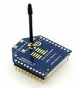
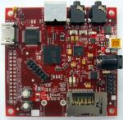
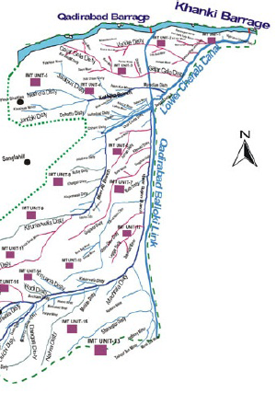
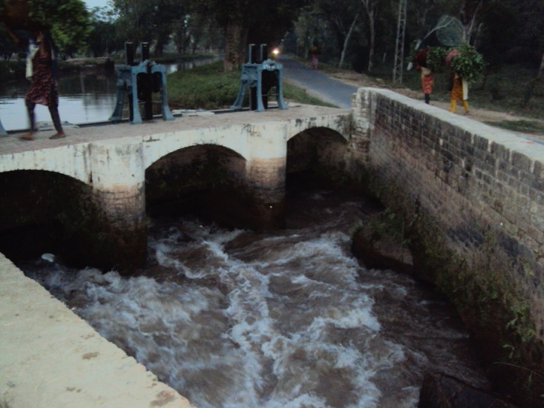
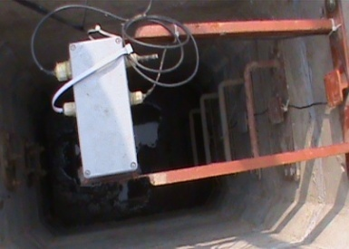
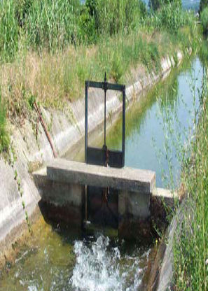
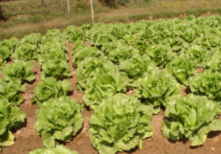
How about a cyber-physical-social system?
Can electronics rescue a hydraulic society?
Wireless connectivity
Embedded controller
Flow Measurements
Gate control
Demand driven delivery to farms

Slide 11
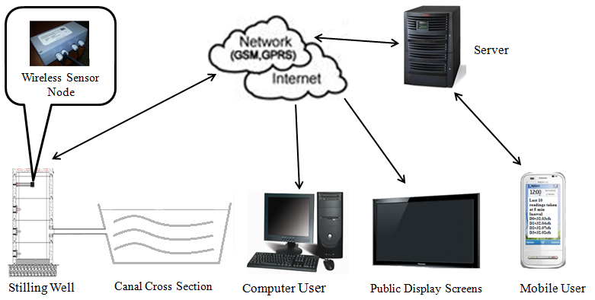
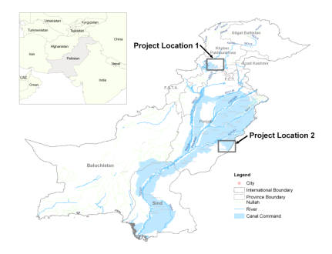
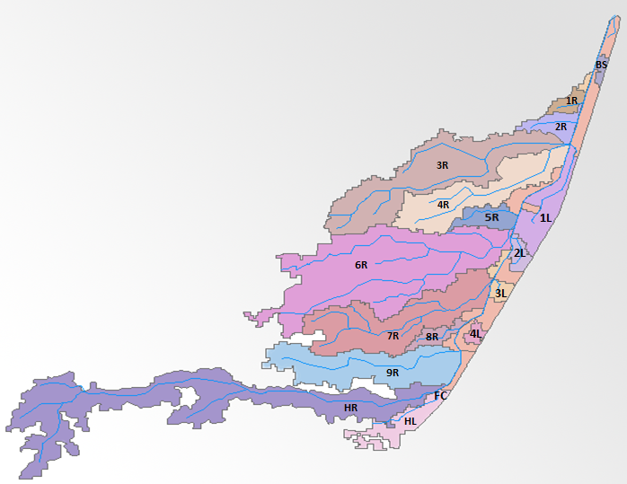
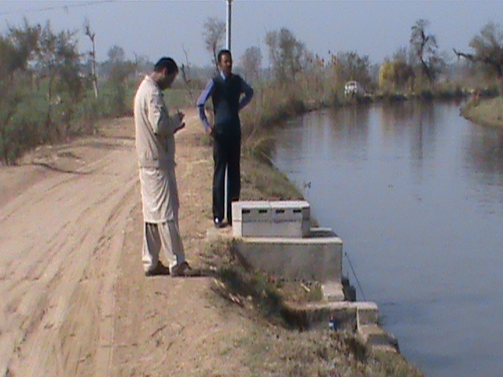
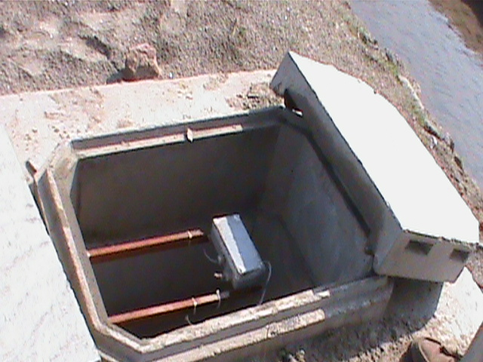
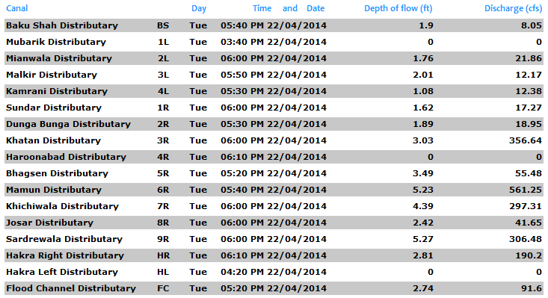
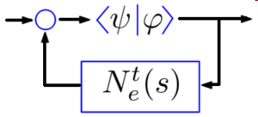


Real-Time Flow Monitoring
System Architecture (above). Field installations (below).
Project Site: 17 Distributaries in Bahawalnagar.
Laboratory for Cyber Physical Networks & Systems
Dept. of Electrical Engineering, LUMS

Slide 12
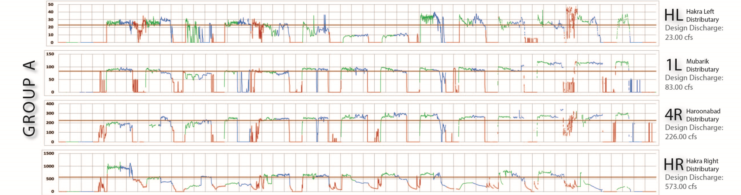
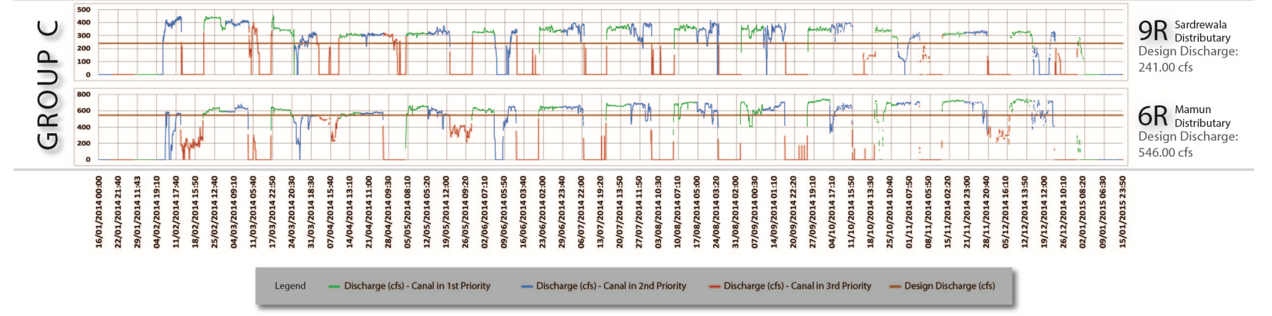
Year Long Monitoring in Hakra Br. Canal Command (2014)
Refs. Ahmad, Muhammad et al. IECON 2014, WSN4DC 2013
Laboratory for Cyber Physical Networks & Systems
Dept. of Electrical Engineering, LUMS

Slide 13
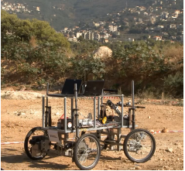
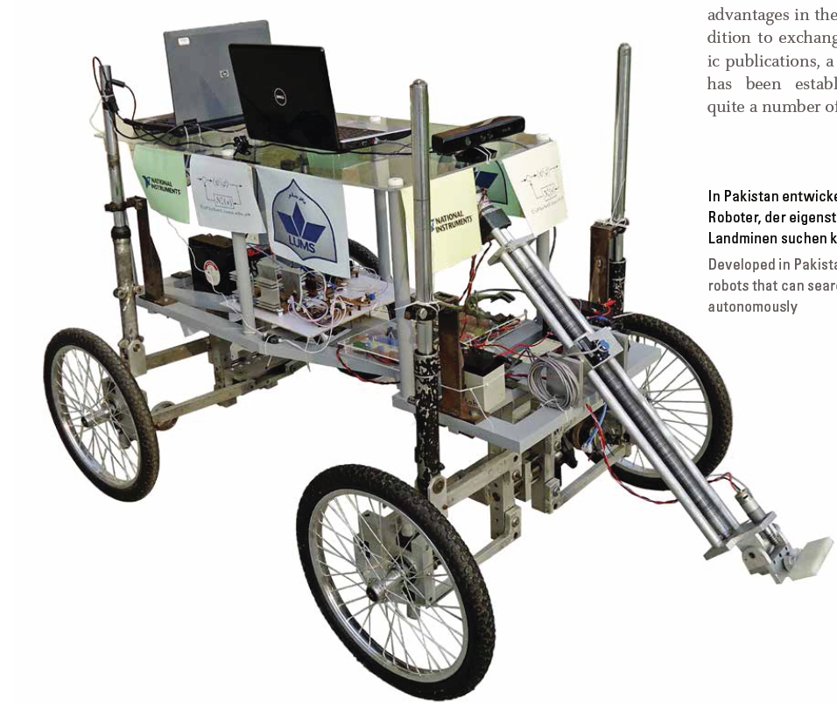
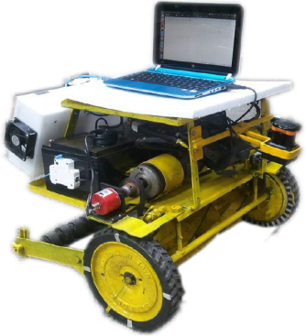
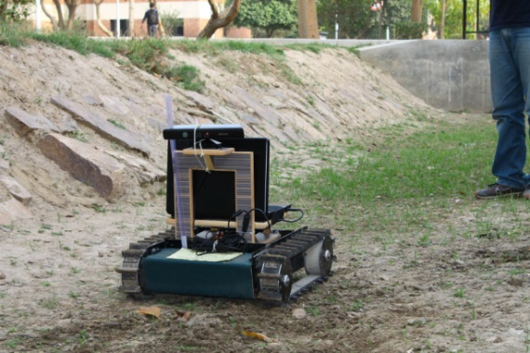
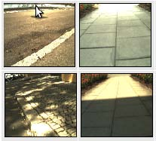
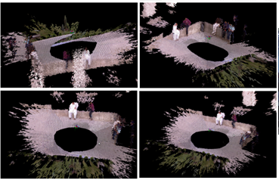
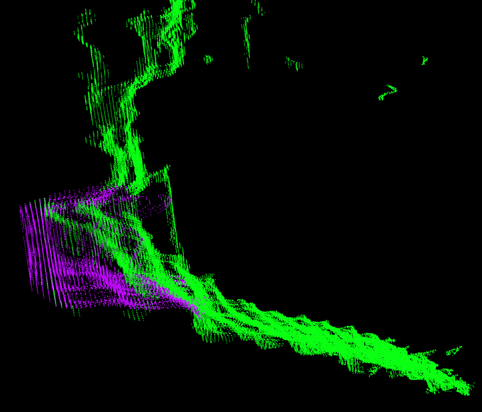
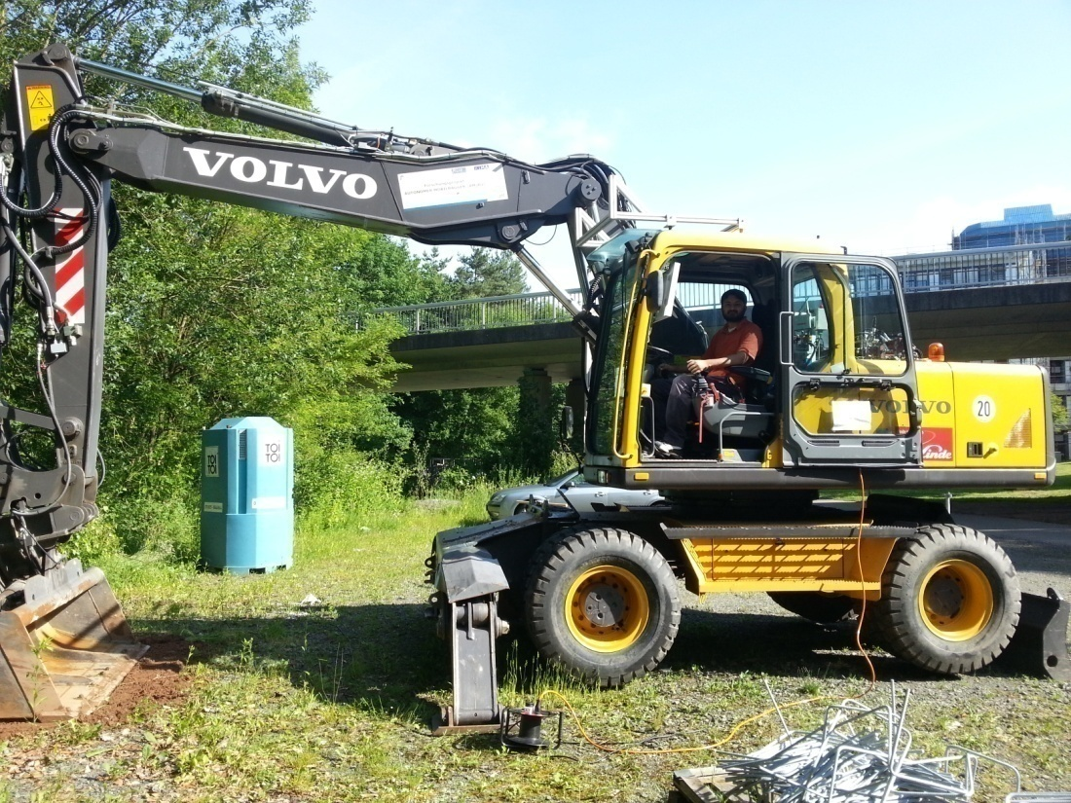



Autonomous Land Vehicles for Demining & Agriculture ALVeDA & MDRD (2010-2013)
Collaboration: RRLab, TU Kaiserslautern
Funding: DAAD, LUMS, National Instruments
Objective: Push performance limits with low-cost vision sensors and simple mechatronics.
Field Experiments: Channel mapping in Lahore (left).
Scanning a minefield in Beirut (right).
Robot Vision: Terrain Classification, RGB-D & Monocular SLAM, Visual Servoing, Soil Estimation in a Bucket Excavator.
Laboratory for Cyber Physical Networks & Systems
Dept. of Electrical Engineering, LUMS

Slide 14
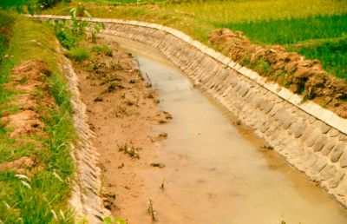
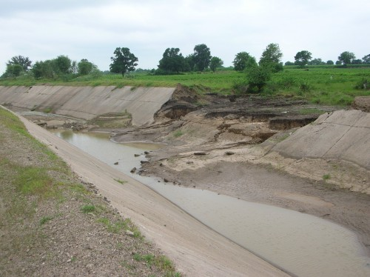
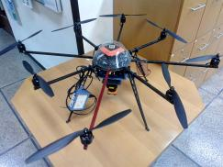
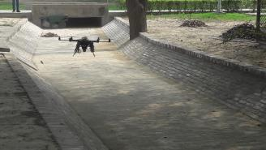
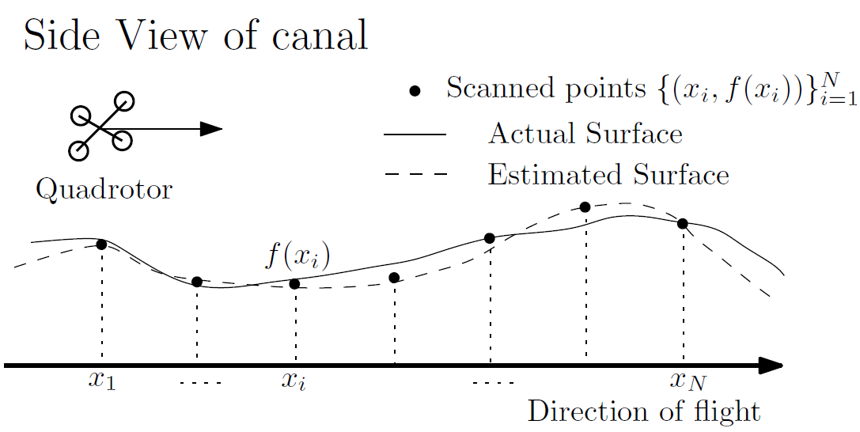
Aerial Mapping of Irrigation Canals for Silt Deposition
Collaboration: RRLab, TU Kaiserslautern
Funding: DAAD, LUMS
Examples of Siltation and bank deterioration in the Indus Basin.
Motivation: Automation of annual canal cleaning operation in the world’s largest irrigation network.
Guassian Processes (GP) based vol. estimation framework incorporating soil model, localization error and sensor noise.
Experiments Video. Octocopter flying over a channel (LUMS campus) collecting scans.
Laboratory for Cyber Physical Networks & Systems
Dept. of Electrical Engineering, LUMS

Slide 15
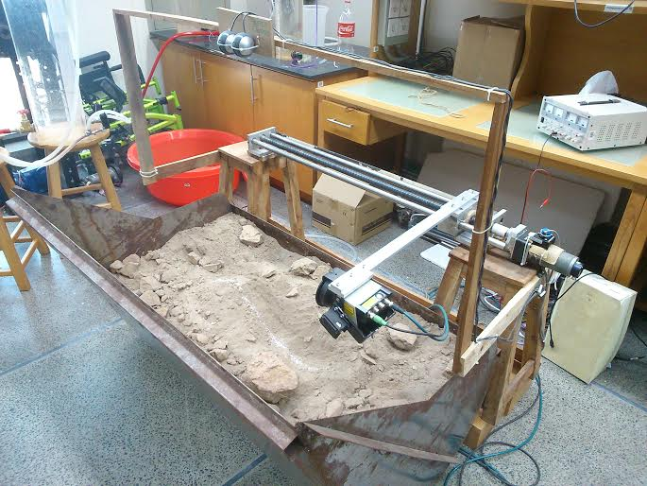
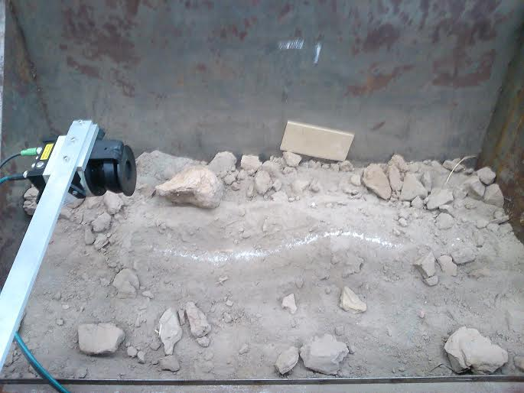
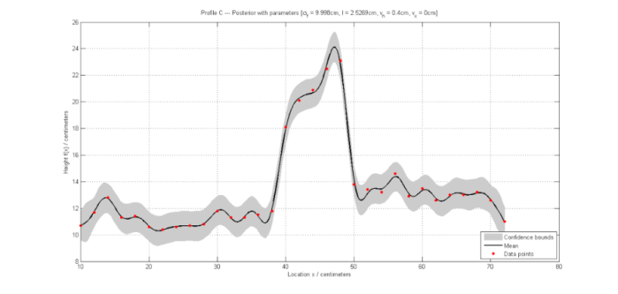
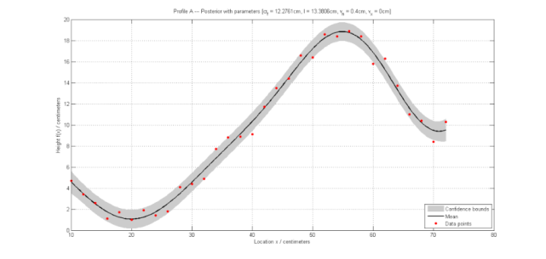
Framework for Aerial Mapping of Silt Deposition
Ref. Anwar, Berns, Muhammad. IROS 2015
Guassian Processes (GP) based vol. estimation framework incorporating soil model, localization error and sensor noise.
Incorporating Localization Errors: GP based vol. estimation framework incorporating soil model, localization error and sensor noise.
Lab Model. Testing estimation limits
Laboratory for Cyber Physical Networks & Systems
Dept. of Electrical Engineering, LUMS

Slide 16
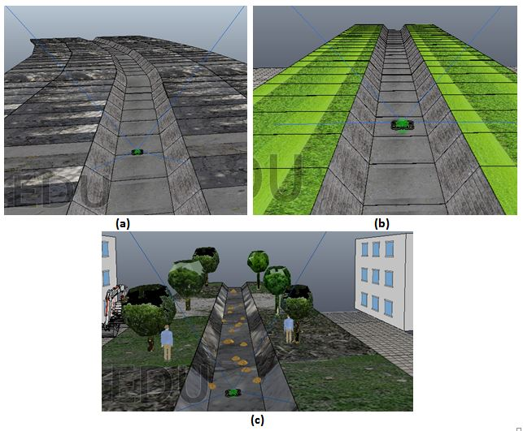
V-REP: Simulation Environment
Different canal scenarios are
generated in V-REP
simulation environment.
3D models of canals are
designed in AutoCAD.
Texture of real canals is
overlayed on these 3D
models in order to
depict real canal scenarios.

Slide 17
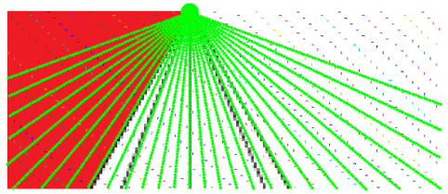
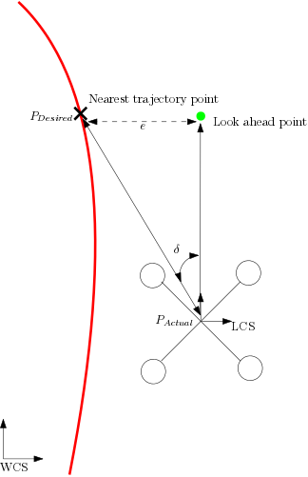
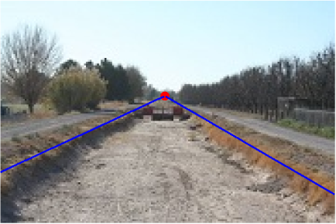
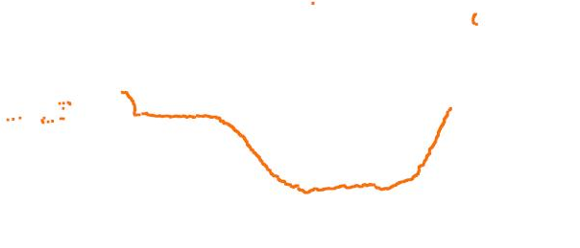
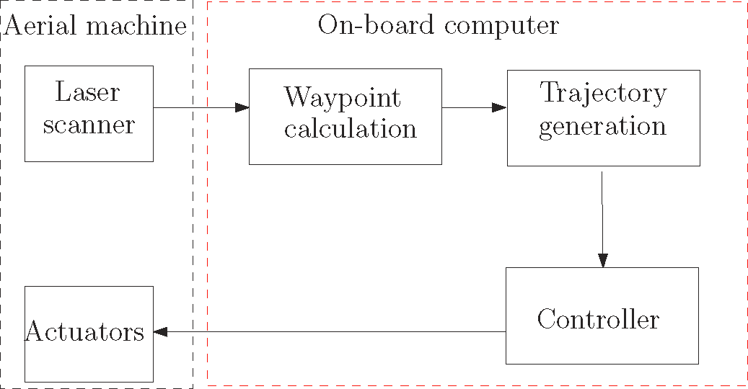
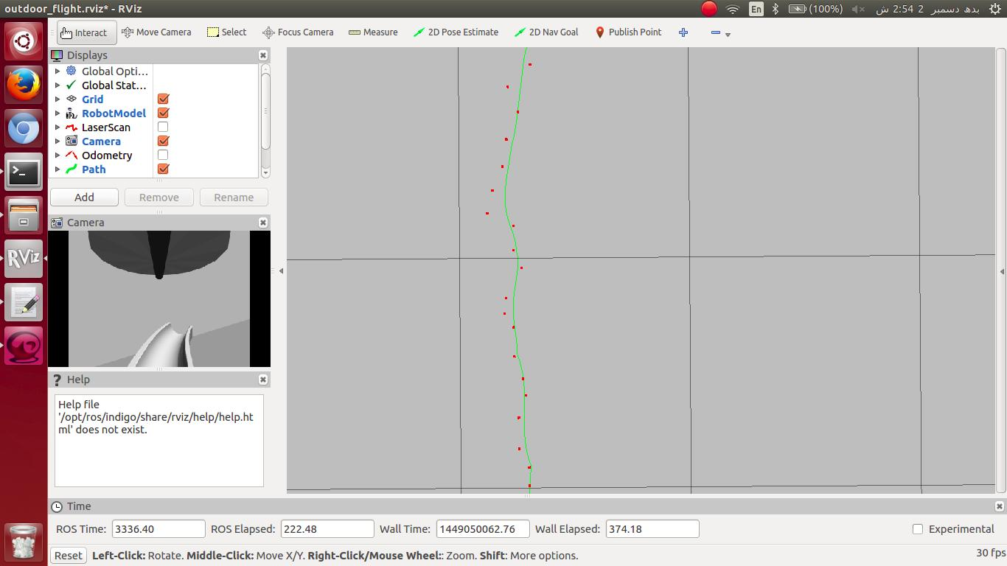
Autonomous Navigation, Localization, Mapping

Slide 18
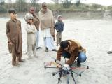
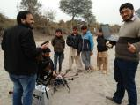
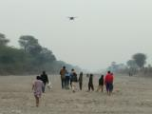

Experiments

Slide 19



Post-processing

Slide 20
How to take research to Industry?
WIT Industry Affiliate Program

Slide 21

WIT – Nestle Collaboration
WIT Industry Affiliate Program
2016-2017

Slide 22





Key Technologies Offered to Industry
Internet of Things (Farm I/O)
Robotics (Road Safety, Aerial Drones)
Computer Vision (Road Safety, Drones)
Wireless Networks (Precision Ag)
Data Analytics (Process Optimization)

Slide 23
Highlights (2016-2017)
Major themes for pilot demonstrations on Nestle Farms
  Precision Agriculture Sensors
  Optimization of Dairy Farm Value Chain
  Milk Transport Safety
  UAV based crop monitoring

Slide 24












Nestle Model Farms (Renala)
Complete Instrumentation & Data Analytics
Ground Water
Grid Electricity
Canal outlet
to Dairy
Road Safety
Milk Plant
Biogas-reactor
Total Surface Water Delivery
Dairy Farm
Fodder
Slurry
NPK Drones
Canal outlet
to Fields
Ground Water
Crop Fields

Slide 25




Instrumenting Nestle crop fields: Soil moisture sensors

Slide 26







On-Farm Water Measurement: Smart flumes
NPK and moisture maps using aerial drones

Slide 27




Instrumenting Nestle dairy farms: Slurry volume sensors

Slide 28






Improving road safety for milk transportation: Sensors and software aids
3D Road surface pointcloud

Slide 29
‘Give and Take’ of the Affiliate Program
What does Nestle Get?
  Fast and cost-efficient prototyping of new technologies
  Previlaged access to WIT international linkages and national research network
  Prominent projection in WIT activities
  New Blue-Sky research
  Research commercialization opportunities
What does WIT get?
  Real testbeds for trying new technologies and data collection
  Nestle expertise in Agronomy, dairy business
  Unrestricted funding for
    Center activities
    Administrative support
    New initiatives
      Seed grant scheme
      Outreach & Events
  Joint funding opportunities

Slide 30
Conclusions
Water problems can inspire a range of ICT inspired systems engineering, informatics and systems analysis solutions.
Industry is facing a wide range of challenges and expects academia to give dependable solutions for hard problems.
Such problem solving requires high quality (publishable) science.

Slide 31

Safe Roadmaps: Vehicle Specific Traversability for Pathways
Collaboration: DLR, TU Kaiserslautern
Funding: LUMS-FIF
Objective:
Determine the traversability of road patch for given vehicles using 3D data of the road surface and vehicle parameters. Road Traversability Index (RTI) Γ : G → [0, 1] is calculated, which indicate the relative safety a road offers to a vehicle.
Framework:
3D Road surface pointcloud
Example Scenarios:
Collision Checking:
Experiment: Disaster Scenario
Results:
Negative Obstacles Collision Checking
Positive Obstacles Collision Checking
Laboratory for Cyber Physical Networks & Systems
Dept. of Electrical Engineering, LUMS
Notes:
31

